Slide 1
GUI Framework
FAST

Slide 2
Frames in the GUI Framework
MRU List
Top Frame for toolbar support
View frame (Actual Page) .
Left frame for Tree view support
The Main Application Frame
Status bar and framework buttons

Slide 3
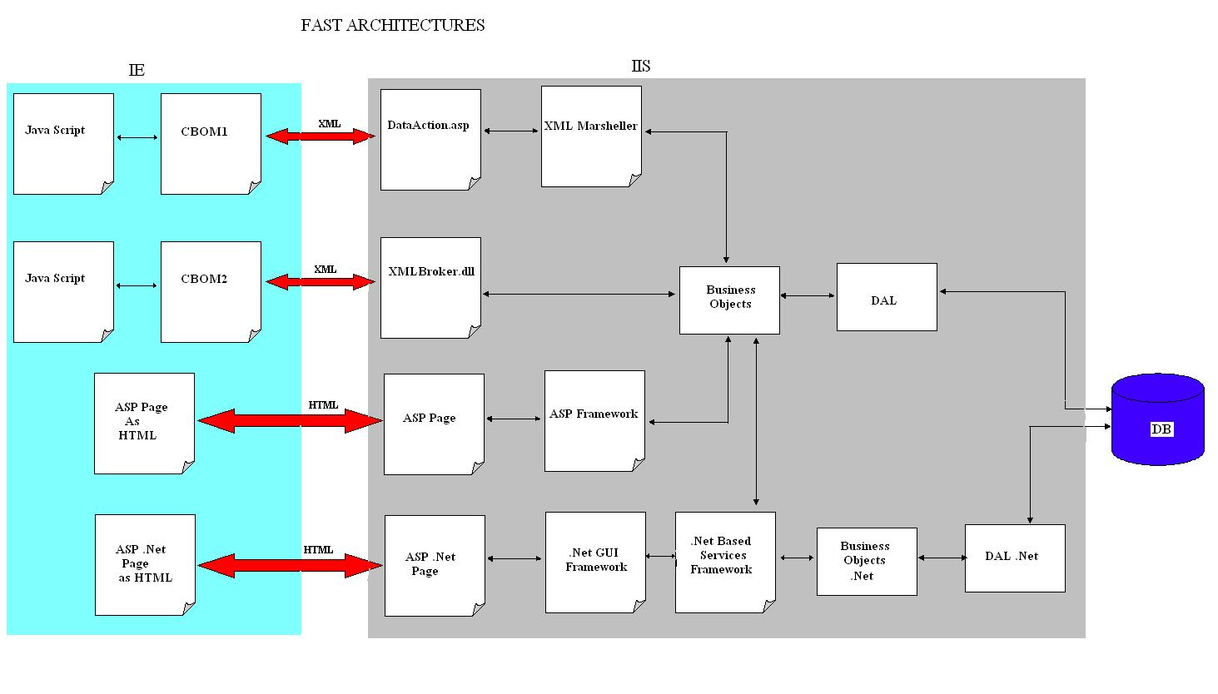
FAST ARCHITECTURE

Slide 4
GUI Framework overview
Frames based application framework.
DHTML is used heavily.
Jscript is the default client side language.
Jscript controls are created and used in the system.
App.htm is the main application page.

Slide 5
CBOM 1
Client Business Object Manager (CBOM) is an applet.
One instance is created in every page.
Proxy of the object is created in the client.
Object is cached on the server and the proxy is cached in the client for the life of the applet.
XML is used to transfer the data between the client and server.

Slide 6
CBOM 1 (Contd …)
ASP Page (DataAction.asp) and COM component (XMLMarshaller) is used on the server side to access the BOs.
XMLMarshaller instance is created on Session start and stored in the session
XMLMarshaller is a VB COM+
Component.
Server BOM (SBOM) object is used to cache the object.

Slide 7
CBOM 1 (Contd …)
A sample usage
var m_cNotes;
var serviceFileID = <%=getFileID()%>;
var strProgId = "SmsFileManagement.ServiceFileNote";
var strBinding = '<OBJECTS NAME="' +strProgId+ '" KEY = "'+ serviceFileID +
'" ACTION = "GET">'+ '<CreateEmpFullName/>'
+ '<CreationDate/>'
+ '<UpdateEmpFullName/>'
+ '<UpdatedDate/>'
+ '<CreationEmployeeID/>'
+ '<Note/>'
+ '</OBJECTS>';
CBOM.SetBinding(strProgId, serviceFileID, strBinding);
m_cNotes = CBOM.GetBo(strProgId, serviceFileID);

Slide 8
CBOM 2
Client Business Object Manager 2 (CBOM) is also an applet
Only one instance is created for the entire application. This made global caching and sharing of objects possible
A context object is created for every page and is available for the page to use
Proxy of the object is created in the client.
Object is cached on the server and the proxy is cached in the client.

Slide 9
CBOM 2 (Contd …)
XML is used to transfer the data between the client and server
ISAPI extension dll (XMLBroker.dll) is used on the server side to create the BOs
XMLBroker has it’s own session management
XMLBroker is a multi-threaded dll created using C++
Microsoft XML Parser is used in CBOM2 for parsing XML and for posting request to the server

Slide 10
CBOM 2 (Contd …)
Sample Usage
var m_cNotes;
var serviceFileID = <%=getFileID()%>;
var sRequest = "ServiceFileNote(" + serviceFileID + ")[]";
m_cNotes = new Object();
m_cNotes = document.BC.loadObject(sRequest);
….
….

Slide 11
GUI Framework navigation
Framework buttons
Fully Qualified ID (FQID)
Child page
  showChild(childID,sURL)
  showParent(sURL)
AutoSave

Slide 12
GUI Framework events
IPage_Populate()
  Load event called after the page is loaded. Create the objects, dynamic controls and load the page.
IPage_Persist()
  Called when the Save button is clicked or AutoSave is triggered. Update the objects with data.
IPage_Validate()
  Called after IPage_Persist(). Do the validation of the data.
IPage_Save()
  Save the data
IPage_Done()
  Called when the done button is clicked
IPage_Unload()
  Release the objects

Slide 13
Jscript Controls
Created using DHTML
Dynamically created using JScript
Sample Controls
  GridView
  TabView
  Toolbar
  TreeView
  Calender
  Input
  Combo-Box

Slide 14
GridView
Grid control with dynamic row addition capability
Very Rich in functionality
Typically rows are added from the BO collection
Sample usage demo

Slide 15
Sample usage of GridView
function initGrid(gridID) {
var oNotesGrid = new aGridView(gridID);
with (oNotesGrid.getColumns()){
add(-1,"",115);
add(-1,"",95);
add(-1,"",115);
}
// Define Column Headers
with (oNotesGrid.getHeaderRows().add().getCells()){
add(-1,"", "Creation&nbsp;User","","center");
add(-1,"", "Creation&nbsp;Date","","center");
add(-1,"", "Last&nbsp;Updated&nbsp;By","","center");
}
return oNotesGrid;
}

Slide 16
Sample usage of GridView (Contd..)
function PopulateData(oNotesGrid) {
var nCount = m_cNotes.GetCount();
for(var i=0; i<nCount; i++) {
var oNote = m_cNotes.Item(i);
var oRow = oNotesGrid.getRows().add(-1, oNote.getID().toString());
with(oRow.getCells()){
add(-1, "", oNote.GetField("CreateEmpFullName"), "text");
add(-1, "", oNote.GetField("CreationDate"), "text", "center");
add(-1, "", oNote.GetField("UpdateEmpFullName"), "text");
}
}
oNotesGrid.paint();
}
<table class="cFrame" cellspacing="0" Style="WIDTH: 100%" ID="Table1"><tr><td id="gridID" style="cursor:default"></td></tr>
</table>

Slide 17
Toolbar
Dynamically created
Individual buttons can be disabled
Supports click event
Sample usage demo

Slide 18
Input Controls
Supports formatting of data
Supports data validation and masking of data
Sample usage Demo

Slide 19
ASP based framework
One Visual Basic component created for every page
XML Bound data controls
  Grid Control
  Input
  Combo Box
Similar pattern is used in .Net based framework
Sample usage

Slide 20
Exercises
Create a simple page and create and update an object using CBOM1 and CBOM2
Create a page and add it to the tree view
Create a page using ASP based framework

